Slide 1
Spring
The Spring Framework (Spring) is an open-source application framework that provides infrastructure support for developing Java applications.
Why?
One of the most popular Java Enterprise Edition (Java EE) frameworks, Spring helps developers create high performing applications using plain old Java objects (POJOs).

Slide 2
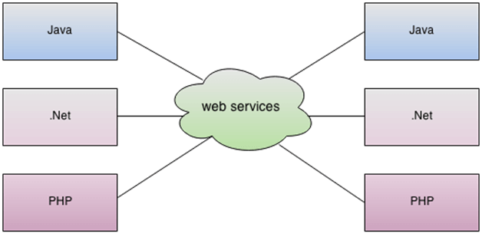
Web service
SOAP Web Services
RESTful Web Services

Slide 3
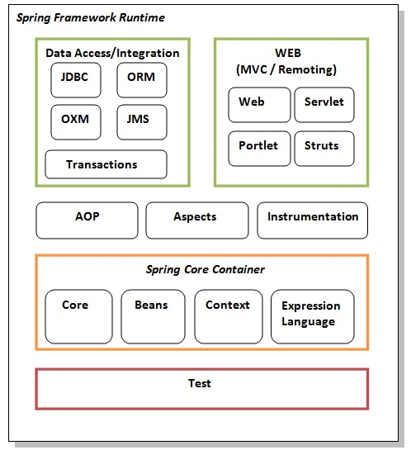
Spring ARCHITECTURE

Slide 4
Advantages
7. Dependency Injection
8. Inversion Of Control
9. Secure
10. Productive
1. Light Weight
2. Flexible
3. Loose Coupling
4. Declarative Support
5. Portable
6. Configuration

Slide 5
IoC Container
The IoC container is responsible to instantiate, configure and assemble the objects.
The main tasks performed by IoC Container are:
* to instantiate the application class
* to configure the object
* to assemble dependencies between objects
Types of IoC containers:
1. Bean Factory
2. Application Context

Slide 6
Types of Injection
1. Constructor Injection
2. Setter Injection
Maven Tool(3.8.4)
* Maven is a popular open-source build tool developed by the Apache Group to build, publish, and deploy several projects at once for better project management.
* he tool provides allows developers to build and document the lifecycle framework.

Slide 7
Maven Repository
Local Repository .m2 Folder
Central Repository (https://repo1.maven.org/)
Remote Repository (https://maven.apache.org/)
What are the ways to create Spring Project
XML
XML + Annotation
Annotation (Java based)

Slide 8
Spring With JDBC
JDBC: JDBC stands for Java Database Connectivity. It is a java application programming interface to provide a connection between the Java programming language and a wide range of databases
Steps:
1. Register the Driver class
2. Create connection
3. Create statement
4. Execute queries
5. Close connection

Slide 9
JDBC Drivers
1. JDBC-ODBC bridge driver
2. Native-API driver (partially java driver)
3. Network Protocol driver (fully java driver)
4. Thin driver (fully java driver)

Slide 10
Spring With JDBC Template
Spring JdbcTemplate is a powerful mechanism to connect to the database and execute SQL queries. It internally uses JDBC api, but eliminates a lot of problems of JDBC API.
Hibernate
Hibernate is a Java framework that simplifies the development of Java application to interact with the database. It is an open source, lightweight, ORM (Object Relational Mapping) tool.

Slide 11
What is JPA?
Java Persistance API(JPA) is a specification that provides certain functionality and standard to ORM tools.
how hibernate can work without JPA specification?
If you're coding directly with Hibernate, you would use only its specific classes (i.e) (org.hibernate.*) and ways, and have no reference to (javax.persistance) anywhere

Slide 12
JPA | Hibernate
Java Persistence API (JPA) defines the management of relational data in the Java applications. | Hibernate is an Object-Relational Mapping (ORM) tool which is used to save the state of Java object into the database.
It is just a specification. Various ORM tools implement it for data persistence. | It is one of the most frequently used JPA implementation.
It is defined in javax.persistence package. | It is defined in org.hibernate package.
The EntityManagerFactory interface is used to interact with the entity manager factory for the persistence unit. Thus, it provides an entity manager. | It uses SessionFactory interface to create Session instances.
It uses EntityManager interface to create, read, and delete operations for instances of mapped entity classes. This interface interacts with the persistence context. | It uses Session interface to create, read, and delete operations for instances of mapped entity classes. It behaves as a runtime interface between a Java application and Hibernate.
It uses Java Persistence Query Language (JPQL) as an object-oriented query language to perform database operations. | It uses Hibernate Query Language (HQL) as an object-oriented query language to perform database operations.

Slide 13
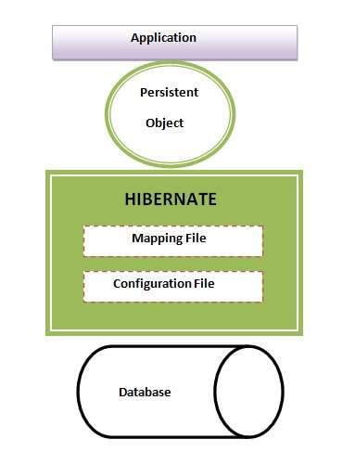
Hibernate Architecture
This is the High Level Architecture of Hibernate with mapping file and Configuration file.

Slide 14
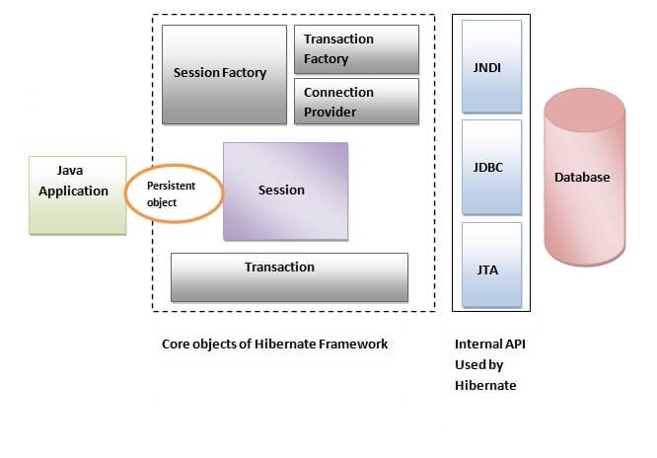

Slide 15
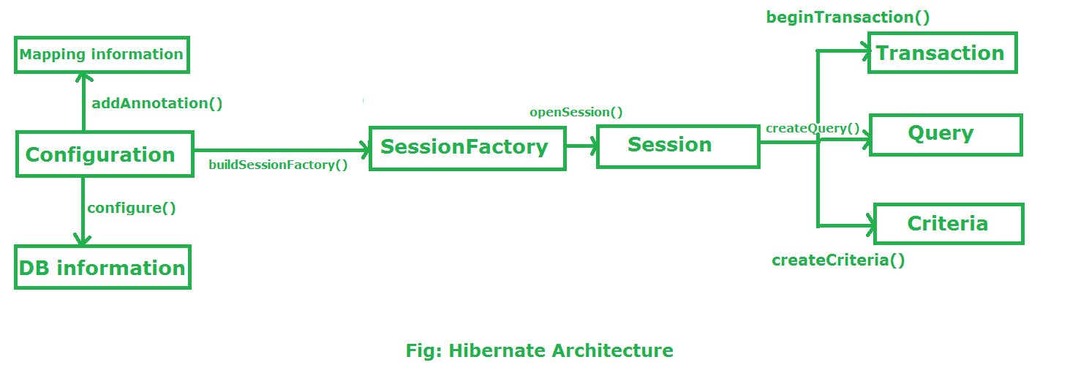
Flow of Hibernate

Slide 16
Components of Hibernate
Configuration object:
The configuration object consist the configuration file used by the hibernate. It mainly consist the information about database connection (hibernate.cfg.xml) and class mapping (.hbm.xml). Configuration object is used to create the object of SessionFactory.
It activate Hibernate Framework
Configuration cfg=new Configuration();
It read both cfg file and mapping files
cfg.configure();

Slide 17
Sessionfactory object:
The SessionFactory object is created from the Configuration object. It is thread-safe object and used by all threads of the application. It acts as a factory for session objects. SessionFactory is an Interface which is present in org.hibernate package and it is used to create Session Object.
buildSessionFactory() method gathers the meta-data which is in the cfg Object.
From cfg object it takes the JDBC information and create a JDBC Connection.
SessionFactory factory=cfg.buildSessionFactory();

Slide 18
Session Object:
Session is an interface which is present in org.hibernate package. Session object is created based upon SessionFactory object.
It opens the Connection/Session with Database software through Hibernate Framework.
Session object is used to perform CRUD operations.
Session session=factory.buildSession();

Slide 19
Transaction object:
The Transaction object is created from Session object. A transaction object represents an atomic unit of work.
Transaction object is used whenever we perform any operation and based upon that operation there is some change in database.
Transaction object is used to give the instruction to the database to make the changes that happen because of operation as a permanent by using commit() method.
Transaction tx=session.beginTransaction();
tx.commit();

Slide 20
Query object:
Query is an interface that present inside org.hibernate package.(HQL)
A Query instance is obtained by calling Session.createQuery().
This interface exposes some extra functionality beyond that provided by Session.iterate() and Session.find():
A particular page of the result set may be selected by calling setMaxResults(), setFirstResult().
Query query=session.createQuery();
Query query = session.createQuery("from Emp");
query.setFirstResult(5);
query.setMaxResult(10);
List list=query.list();

Slide 21
Criteria object:
The Criteria object is created from the Session object. It is used to define and execute the object oriented criteria queries.
Criteria criteria=session.createCriteria();
Crietria c = session.createCriteria(Emp.class);
c.addOrder(Order.asc("salary"));
List list=c.list();

Slide 22
Advantages of Hibernate
Hibernate framework is an open source framework.
Hibernate framework is a high performance framework because of its internal cache.
It maps java classes to database tables using XML files and if any change is made to the database than we have to change these XML files only.
It provides a database independent query language HQL (Hibernate Query Language).
It provides the facility to create tables from your java application.
No application server is required.

Slide 23
JDBC 1. In JDBC, one needs to write code to map the object model’s data representation to the schema of the relational model. 2. JDBC enables developers to create queries and update data to a relational database using the Structured Query Language (SQL). 3. JDBC code needs to be written in a try catch block as it throws checked exception(SQLexception). 4. Creating associations between relations is quite hard in JDBC. 5. JDBC is database dependent i.e. one needs to write different codes for different database.
Hibernate
Hibernate maps the object model’s data to the schema of the database itself with the help of annotations.
Hibernate uses HQL (Hibernate Query Language) which is similar to SQL.
Whereas Hibernate manages the exceptions itself by marking them as unchecked.
Associations like one-to-one, one-to-many, many-to-one, and many-to-many can be acquired easily with the help of annotations.
Whereas Hibernate is database independent and same code can work for many databases with minor changes.

Slide 24
Spring Core Annotation
@Configuration
@Bean
@Component
@ComponentScan
@Controller
@Required
@Autowired
@Service
@Repository, etc.

Slide 25
Spring MVC

